Slide 1
Week 3 Unique value proposition (UVP) and concept generation
DESN2000 Workshop
Design Next, workshop 3

Slide 2
Introduction
Whole class
Solution / Technology
The aim of today’s workshop is for every team to draft a unique value proposition statement followed by a concept generation session.
The unique value proposition statement:
Clearly explains which problem / needs you want to address
Guides your design decisions towards solutions that actually create new value for users and stakeholders
Move forward from the project brief to the problem definition with a clear idea of the values your technical solution must have
Problems / Needs
Users / Customers / stakeholders
UVP
Introduction | Value proposition | UVP Statement | Ideation | Ideas evaluation | Wrap up
5 min | 20 min | 20 min | 30 min | 20 min | 5min
all | group | group | group | group | individual

Slide 3
Introduction
Whole class
Your UVP should consider:
What does your solution do that creates the most value for your user? How does it relieve their pains or create gains for them in other ways?
What does your solution do that others don’t? How does your solution differentiate… what makes it special? Consider existing other solutions … or what the other teams in this course are developing.
Introduction | Value proposition | UVP Statement | Ideation | Ideas evaluation | Wrap up
5 min | 20 min | 20 min | 30 min | 20 min | 5min
all | group | group | group | group | individual
Notes:
Explain that there’s a nuance with the UVP.
UVP describes pain points but can also include solution and how this provides value
Problem statement should only describe the problem and pain points (leaving room to generate solution/value)

Slide 4
Introduction
Whole class
Today’s workshop will involve several group activities. For these activities you may use one of the following tools to complete the activities:
Whiteboard in MS Teams, can be shared using screenshare in breakout rooms. Blackboard and Zoom have similar tools.
A MIRO board as you’ve done for the user research plan.
Google Jamboard (https://jamboard.google.com/) is also a nice solution.
Introduction | Value proposition | UVP Statement | Ideation | Ideas evaluation | Wrap up
5 min | 20 min | 20 min | 30 min | 20 min | 5min
all | group | group | group | group | individual

Slide 5
Value Proposition Canvas
Group
A Value Proposition Canvas helps ensure you have a good product-customer fit…
This means your solution actually creates value for your intended user… meaning it solves a problem for them, or makes their lives better in some way.
There is a specific canvas (Value Proposition Canvas) your team can use to share insights from the user research, reflect on their behaviours, pains and gains.
Introduction | Value proposition | UVP Statement | Ideation | Ideas evaluation | Wrap up
5 min | 20 min | 20 min | 30 min | 20 min | 5min
all | group | group | group | group | individual

Slide 6
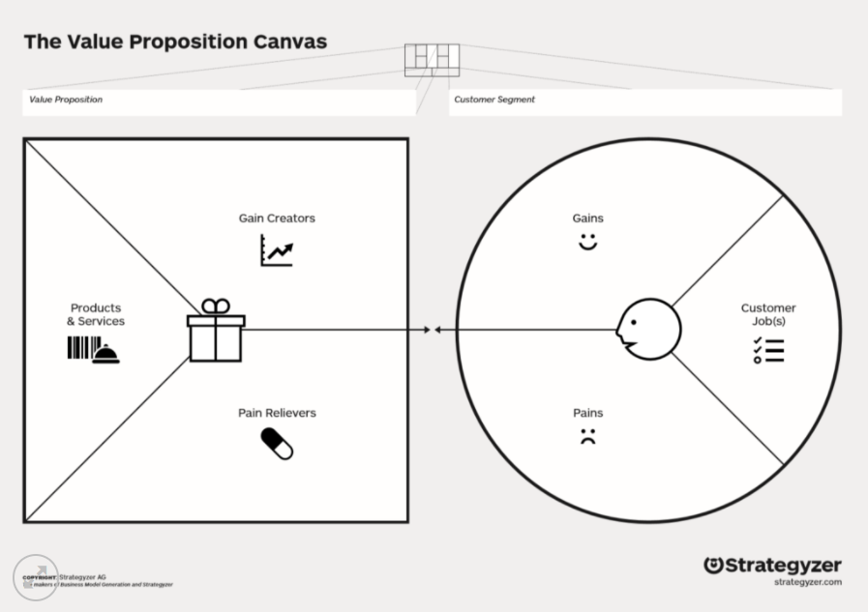
Value Proposition Canvas
Group
Strategyzer’s Value Proposition Canvas:
Manual (Pdf)
Explained (Youtube)
Blank (Pdf)
Introduction | Value proposition | UVP Statement | Ideation | Ideas evaluation | Wrap up
5 min | 20 min | 20 min | 30 min | 20 min | 5min
all | group | group | group | group | individual

Slide 7
Value Proposition Canvas
Group
Evaluate the list of values
Think about how your solution relieves user pains and creates user gains for them.
Select the 10 most important values for your statement
Introduction | Value proposition | UVP Statement | Ideation | Ideas evaluation | Wrap up
5 min | 20 min | 20 min | 30 min | 20 min | 5min
all | group | group | group | group | individual

Slide 8
UVP Statement
Write a draft unique value proposition
statement using one of these templates
(link here for more examples)
Vlaskovits & Cooper’s Customer-Problem-Solution | David Cowan’s Pitchcraft | Geoffrey Moore’s Value Positioning Statement | Steve Blank XYZ | The Minto Pyramid
Customer: ______ (who your customer is). Problem: ______ (what problem you’re solving for the customer). Solution: ______ (what is your solution for the problem). | 1. Highlight the enormity of the problem you are tackling. 2. Tell the audience up front what your company sells. 3. Distill the differentiation down to one, easy-to-comprehend sentence. 4. Establish credibility by sharing the pedigree of the entrepreneurs, customers, or the investors. | For ______ (target customer) who ______ (state need/opportunity) our ______ (product name) is ______ (product category) that ______ (state benefit) | We help X do Y doing Z. | Situation — describe what is the current situation Complication — describe the issue in the situation Question — describe the question in response to the issue Answer — suggest answer to ease out or mitigate the issue
Introduction | Value proposition | UVP Statement | Ideation | Ideas evaluation | Wrap up
5 min | 20 min | 20 min | 30 min | 20 min | 5min
all | group | group | group | group | individual

Slide 9
Ideation session
Group
Appoint a facilitator: keeps the pace, motivates the team
Time limits help to keep pressure: don’t stare at a blank canvas for long
No criticism at this stage
Silly ideas are good => let go of self-editing
Focus on quantity, not quality
Keep your Unique Value Proposition at the centre of your creative session
Keep in mind your research findings and what you know so far about your stakeholders
Read you UVP statement every 10 minutes to make sure you don’t lose the direction!
Document the outcomes: make sure this hard work is put to good use!
Introduction | Value proposition | UVP Statement | Ideation | Ideas evaluation | Wrap up
5 min | 20 min | 20 min | 30 min | 20 min | 5min
all | group | group | group | group | individual

Slide 10
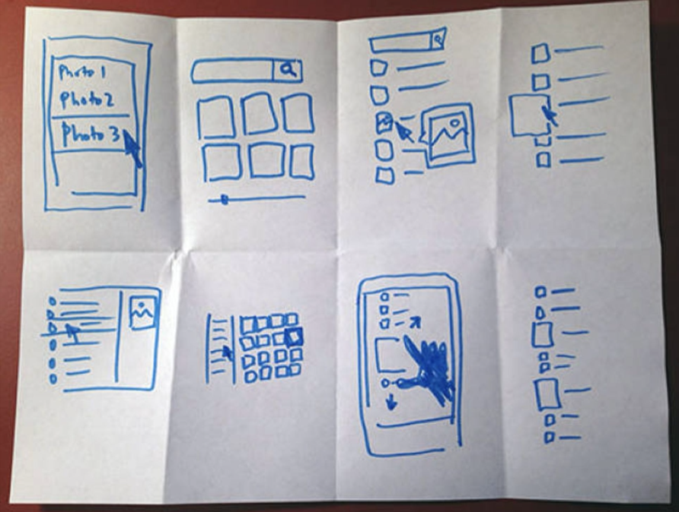
Crazy 8’s
5 minutes, 8 ideas per person
Take your value proposition
Have something to write and draw on (whiteboard, A4 paper, post-it notes)
Start a timer for 5 minutes and let go of self-critique :)
You don’t have to stop at 8 ideas, that’s just the minimum.
General rules for idea generation:
You’ll need to turn off the self-editing and just get your ideas on paper.
No need to worry about making sketches pretty.
Separate idea generation from discussion and critique
If you get stuck, try repeating an earlier sketch with a small variation.
This type of exploration is useful and it keeps you moving.
Introduction | Value proposition | UVP Statement | Ideation | Ideas evaluation | Wrap up
5 min | 20 min | 20 min | 30 min | 20 min | 5min
all | group | group | group | group | individual

Slide 11
Ideas evaluation
Group
Reflect on the ideas collected so far:
What areas (kind of ideas/solutions/challenges) are covered well?
Which ideas are answering better to your problem and the needs of your stakeholders?
Keep on eye out for what you may be missing (reflect on the insights from your research and check if you are considering them with your solutions)
Think of alternative solutions (less is more!)
If a challenge feels too big, subdivide and solve the parts
It may help to pin up all output on a wall, lay it out on a table, etc. to get a good overview
Introduction | Value proposition | UVP Statement | Ideation | Ideas evaluation | Wrap up
5 min | 20 min | 20 min | 30 min | 20 min | 5min
all | group | group | group | group | individual

Slide 12
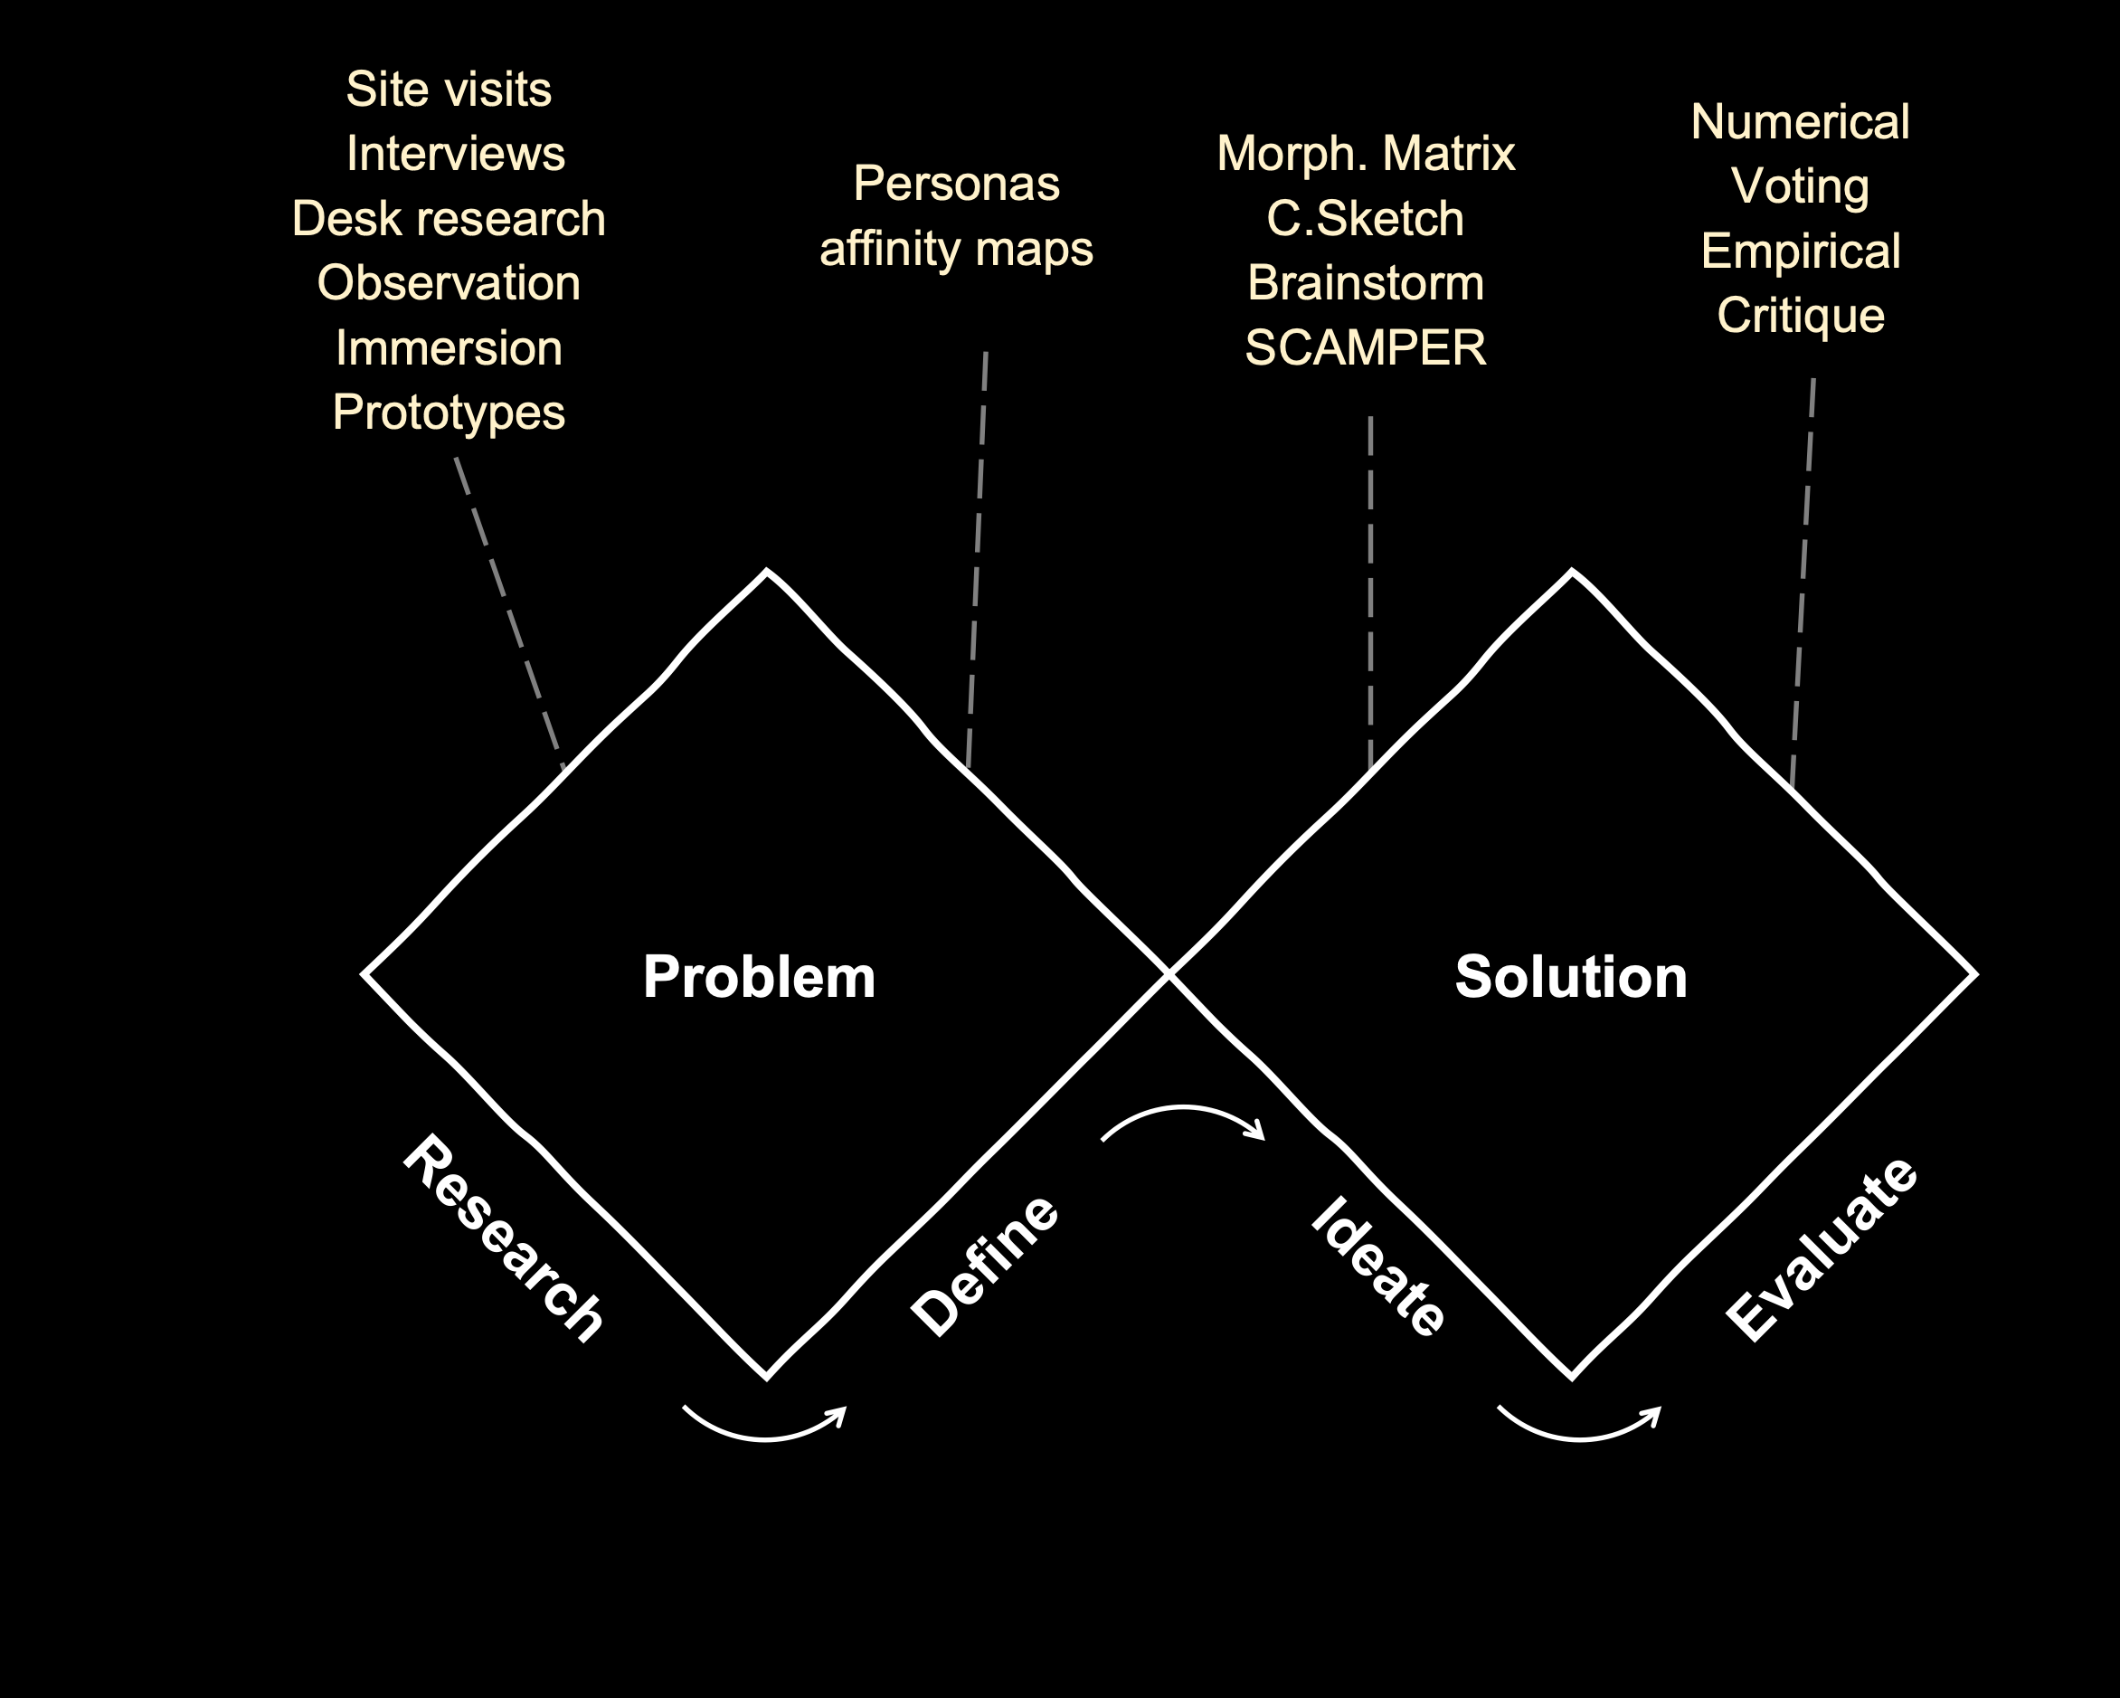
Wrap
Whole class
Brief reflection
Each group to share their progress, use of ideation methods
Looking ahead:
Next step is go ahead with the best solution
Consider your UVP statement when you take decisions for your solution
Refer to the Week 3 lecture to make sure you are using a systematic selection method
Week 2
Week 3
Week 4
by Week 5
Introduction | Value proposition | UVP Statement | Ideation | Ideas evaluation | Wrap up
5 min | 20 min | 20 min | 30 min | 20 min | 5min
all | group | group | group | group | individual

Slide 13
Next Steps
Finalise your personas and user needs
Write your team’s problem statement
Work on creating requirements from user needs
Remember the format and principles covered yesterday
If req are done, get started with concept generation
Some example methods: brainstorming, crazy 8’s, C sketch, SCAMPER, 6-8-5 sketch
If concept generation is done, do a concept evaluation
Use DECISION MATRIX for concept evaluation (or any other tools to methodically compare)
Identify an appropriate selection criteria for comparing different concepts
Write your UVP at any stage your team feels ready
Little nuance but UVP != problem statement because:
UVP describes pain points but can also include solution and how this provides value
Problem statement should only describe the problem and pain points (leaving room to generate solution/value)
REMINDER: presentation next week!
Introduction | Value proposition | UVP Statement | Ideation | Ideas evaluation | Wrap up
5 min | 20 min | 20 min | 30 min | 20 min | 5min
all | group | group | group | group | individual

